Slide 1
CAP476:
Data Communication and Networking
Unit-I
Network Basics

Slide 2
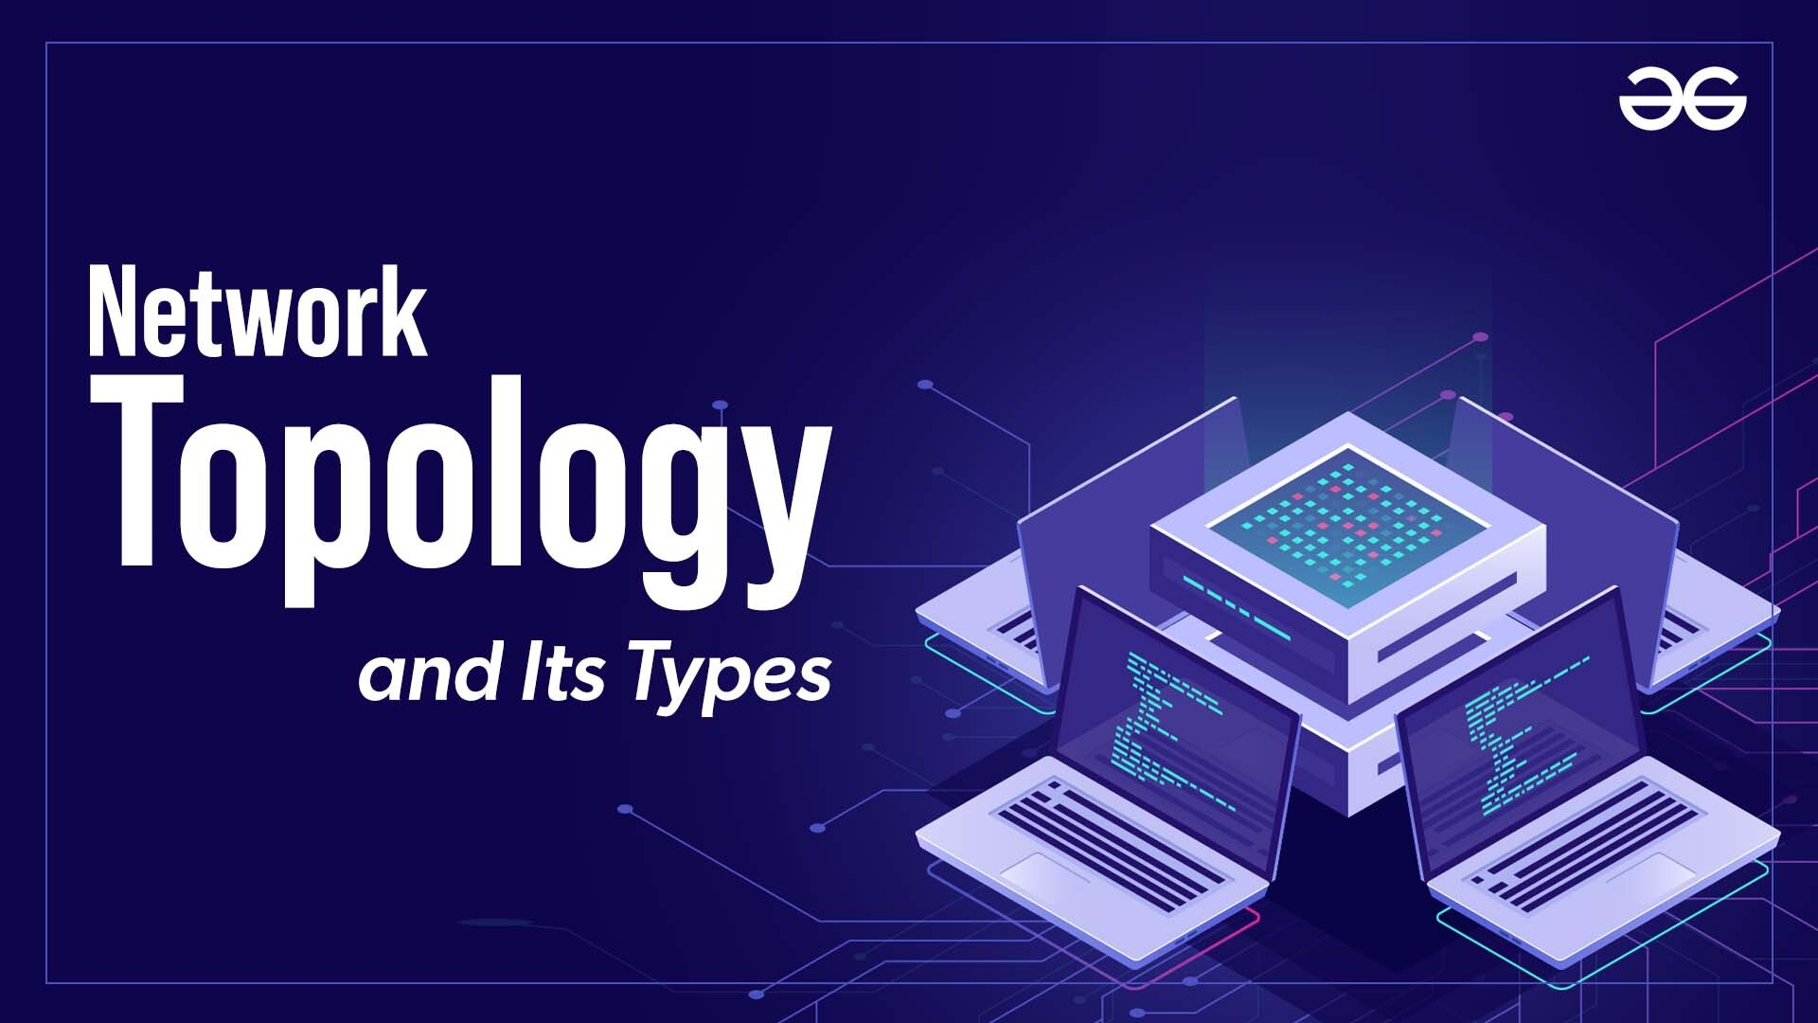
Computer Networks

Slide 3
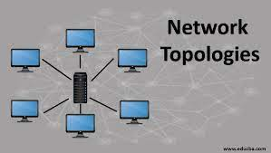
Network Topology
Arrangement of networked devices
Shows links, nodes’ layout
Determines data communication paths
Physical or logical network structure
Influences efficiency, reliability

Slide 4
Types of Topologies
Point-to-Point topology
Bus topology
Star topology
Ring topology
Mesh topology
Tree (Hierarchical) topology
Daisy Chain
Cellular topology
Hybrid Topology

Slide 5

Point-to-Point topology
Connects exactly two hosts directly
Uses dedicated private communication link
Simple, cost-effective network design
Entire bandwidth reserved for communication
High security with no intermediates

Slide 6
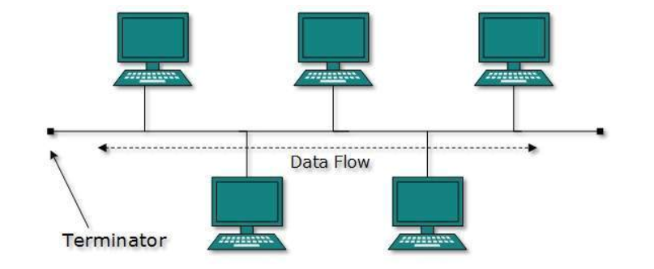
Bus topology
Devices connect to single cable
Cable is called backbone bus
Data travels entire length cable
Nodes listen for correct address
Terminators stop signal reflections

Slide 7
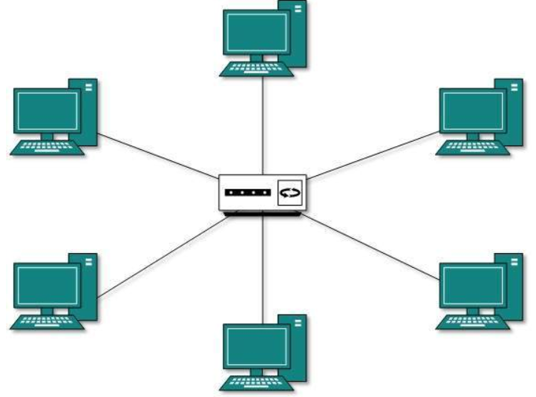
Star topology
Devices connect to central hub
Hub controls data transmission
Nodes do not connect directly
Hub can be switch/hub
If hub fails, network fails

Slide 8
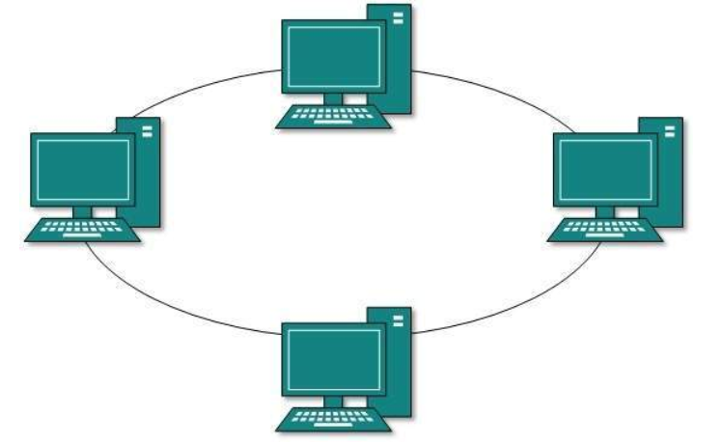
Ring topology
Devices connected in circular loop
Each device connects two neighbors
Data travels one direction only
Each node acts as repeater
Failure breaks entire network

Slide 9
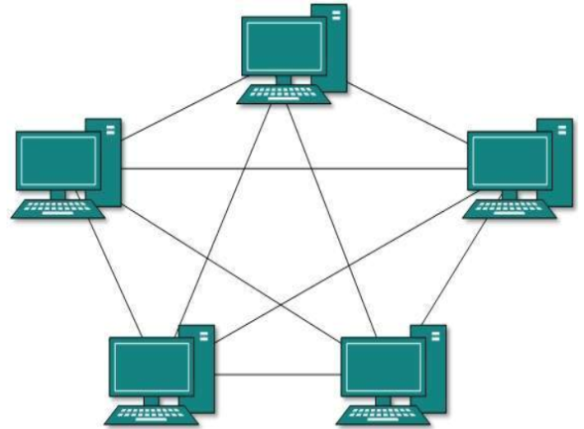
Mesh topology
Devices connect directly to many
Each node links multiple others
Provides multiple data paths
Supports full and partial mesh
Highly reliable, self-healing network

Slide 10
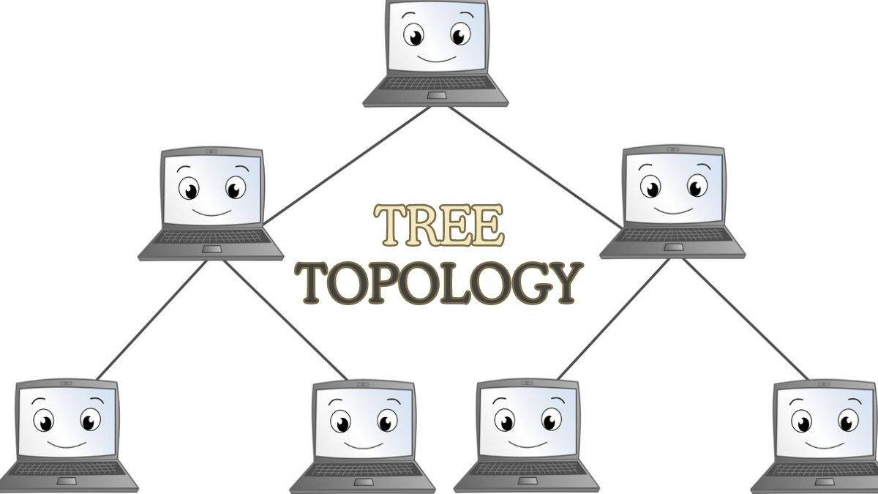
Tree (Hierarchical) topology
Devices arranged in hierarchical levels
Root node connects multiple branches
Combines star and bus topologies
Scalable and easy to expand
Failure can isolate segments

Slide 11

Daisy Chain
Devices connected in linear series
Data travels from one device
Simple, cost-effective network setup
Easy to add new devices
One failure disrupts whole chain

Slide 12
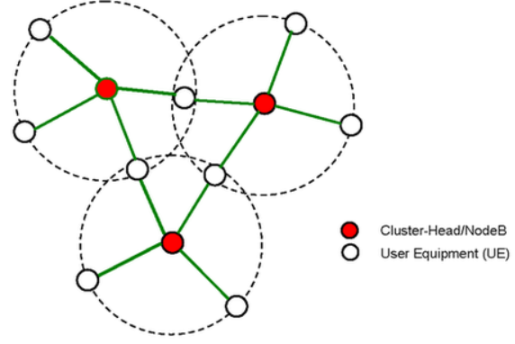
Cellular topology
Network divided into geographic cells
Each cell served by tower
Frequencies reused in non-adjacent cells
Supports large mobile user numbers
Facilitates wireless communication, roaming

Slide 13
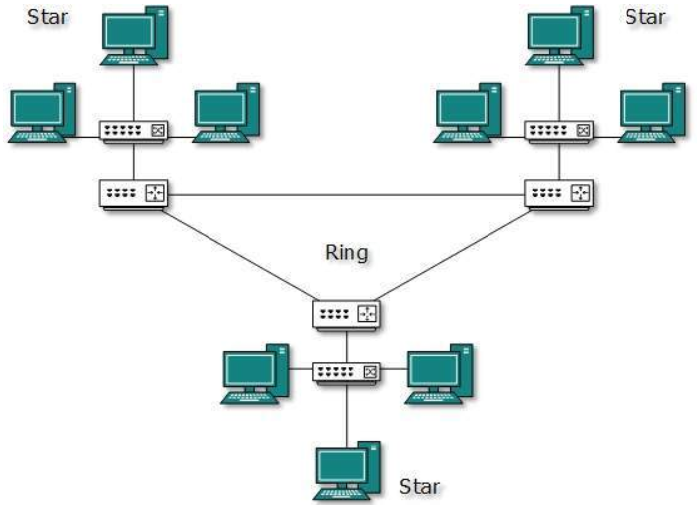
Hybrid Topology
Combines two or more topologies
Leverages strengths of each type
Flexible and scalable network design
Enhances fault tolerance, reliability
Suitable for diverse network needs

Slide 14


